Slide 1

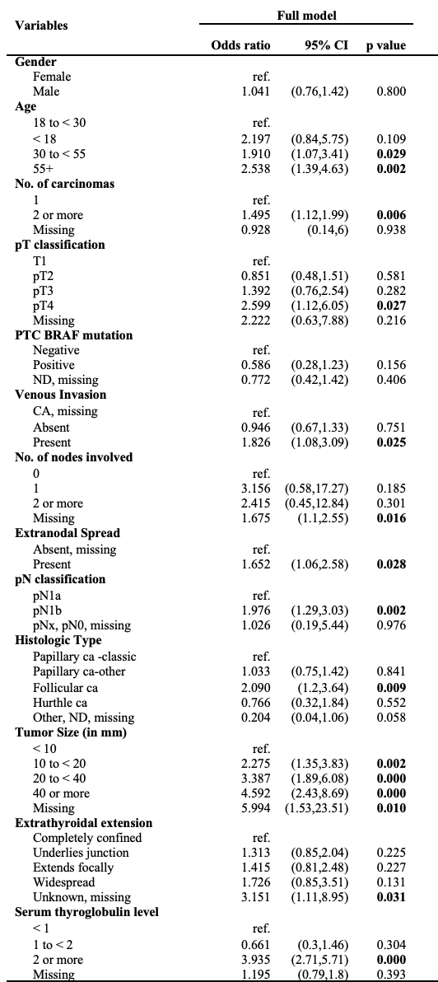
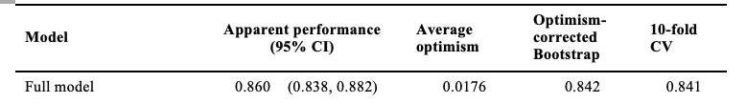
Development of a thyroid cancer recurrence prediction calculator: A regression approach
Sajeeka Nanayakkara¹, Jiaxu Zeng¹, Jean Li¹, Mark Sywark², Carolina Nylen², Robin Turner³
Department of Preventive and Social Medicine, Dunedin School of Medicine, University of Otago.
Endocrine Surgical Unit, University of Sydney.
Biostatistics Centre, University of Otago.
Introduction
Results
Thyroid cancer is a disease in which malignant (cancer) cells form in the tissues of the thyroid gland. It is the most common type of endocrine cancer. The thyroid cancer staging calculator developed by the American Thyroid Association has been recognized as one of the most efficient tools for assisting clinicians in making clinical decisions for the treatment strategy of cancer. However, it has been realised that the calculator is missing the information on patients’ serum Thyroglobulin level, which is crucial for predicting recurrence of thyroid cancer in practice. The primary aim of this study is to update the current calculator with serum thyroglobulin information, and hence to improve the performance of current calculator for predicting structural recurrence of thyroid cancer.
Table 1. Estimated odd ratio and 95% confidence interval from logistic regression model.
Table 2: Internal validity of the model.
Methods
The study used the tertiary thyroid cancer service database in Australia and the dataset consists of electronic medical records of 3565 thyroid carcinoma (TC) patients aged 6-99 years who underwent surgery for TC for the first time at the Endocrine Surgical Unit of the University of Sydney from 2000 to 2018.
Anonymised data available for each patient include age, age at operation, sex, number of carcinomas presented in the operation, size of the greatest tumor, the histologic type of carcinoma, extrathyroidal extension status of tumors, the pathologic staging of the primary tumor, the presence of venous invasion of the primary tumor, the presence of extranidal spread, the number of lymph nodes and the serum thyroglobulin level presented in the scans.
The outcome was the detection of thyroid cancer recurrence proven on fine-needle biopsy or histopathology. Logistic regression analysis was used to estimate the risk of recurrence. A set of important predictors was chosen under close guidance of experienced clinicians. Cross-validation and bootstrap methods were used to assess the internal validity of the model, and the performance was assessed based on the the area under the receiver operating characteristic curve (AUC).
Conclusions
Number of lymph nodes, tumor size and serum thyroglobulin level were strong predictors of cancer recurrence.
The risk prediction model performed reasonably well.

